Slide 1
Biological Nutrient Removal Introduction
Kay Curtin

Slide 2
Introduction
Nutrients are essential to growth/life
Too many can be harmful
Adjusting conditions enables nutrient removal biologically
Adjustment processes not simple nor easy

Slide 3
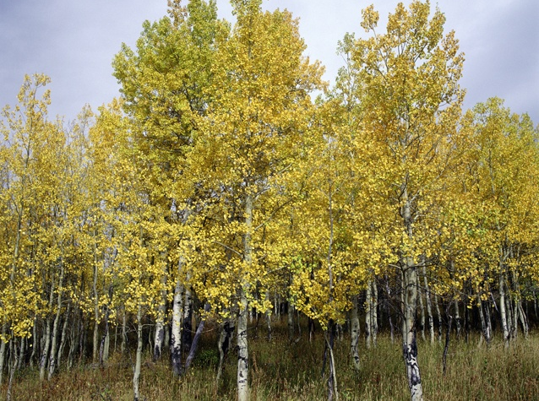
Nutrients are essential to growth/life
Essential for – humans, plants, animals
Carbon
Phosphorus
Nitrogen
Notes:
[CLICK] to bring in 3 nutrients

Slide 4
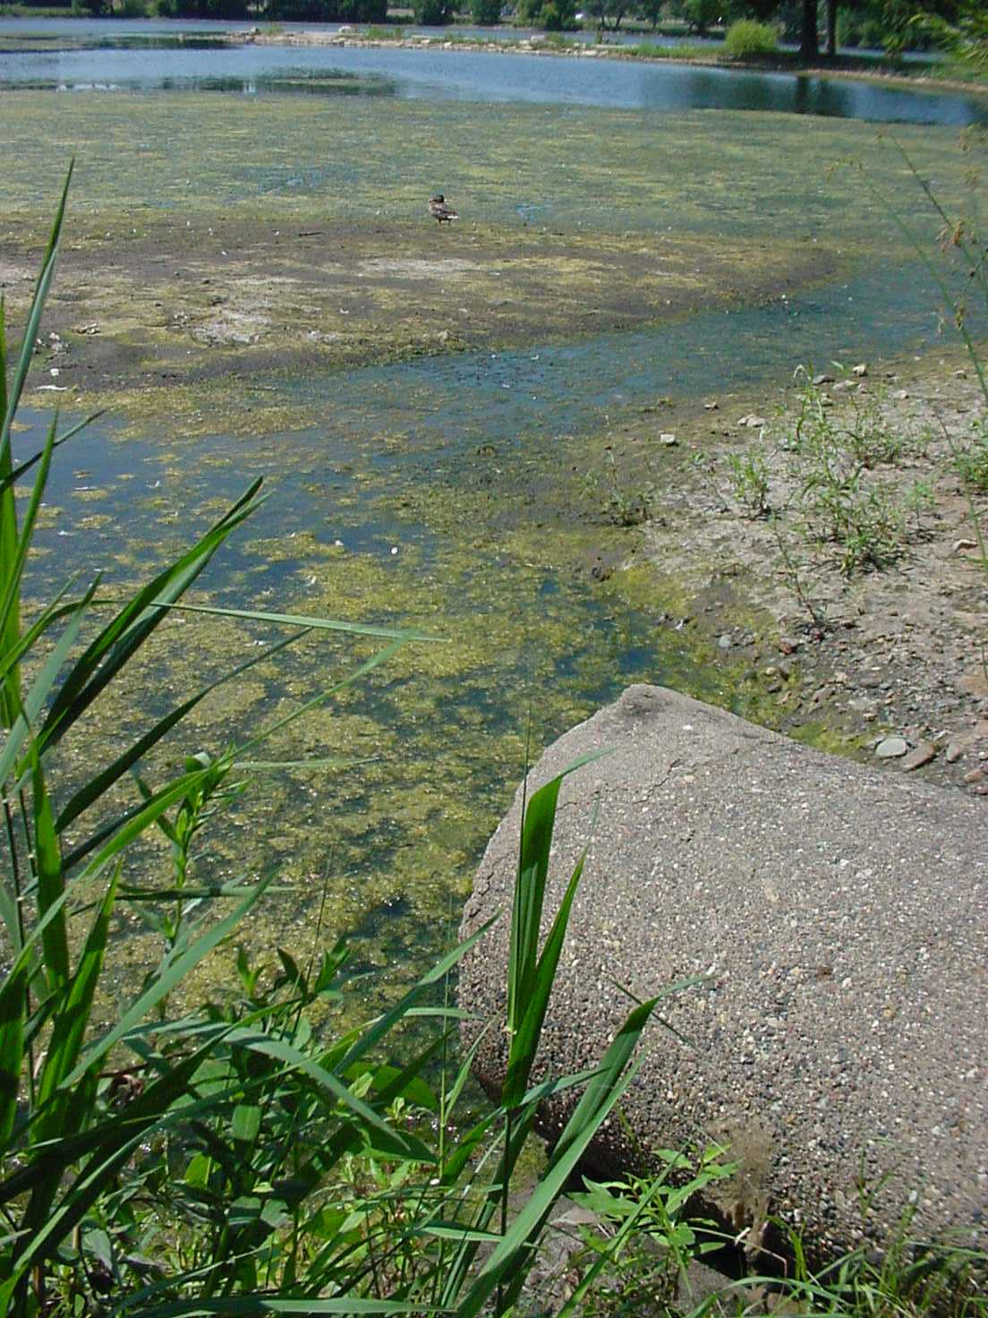
Too many can be harmful
Eutrophication (premature aging) of lakes
Ammonia nitrogen toxic to aquatic life
Nitrates – blue-baby syndrome

Slide 5
Carbon (C)
Anything organic –
human waste, food waste, plant material
Sources in wastewater
Sampling to find out carbon levels
Permit requirements
Biochemical Oxygen Demand (BOD)
Volatile Solids Analysis
Measured in CBOD (Carbonaceous BOD) ~25 mg/L (CalMoAvg) ~40 mg/L (MaxCalWk)
Notes:
Measured in CBOD (Carbonaceous BOD) typical values are 25 mg/L (CalMoAvg) and 40 mg/L (MaxCalWk) although some facilities may be more stringent.

Slide 6
Phosphorus (P)
Human & food waste, runoff, fertilizers, detergents, water softeners, phosphoric acid (metal plating and soda)
Sources in wastewater
Types in wastewater
Permit requirements
Phosphate form | Typical conc. (mg/L)
Orthophosphate, PO₄⁻³-P | 3.0 – 4.0
Polyphosphates | 2.0 – 3.0
Organic phosphates | 0.7 – 1.0
Total as P | 5.7 – 8.0
(Types)
Source: EPA
Total phosphorus – ~< 1mg/L and/or mass limits
Notes:
Phosphorus limits of 1 mg/L or less common, mass limits based on numerous factors (stream location, basin, upgrades)

Slide 7
Nitrogen (N)
Anything organic – human waste, urea, fertilizers
Sources in wastewater
Types in wastewater
Permit requirements
Total Kjeldahl Nitrogen = ammonia nitrogen + organic nitrogen
Limits for ammonia nitrogen, total nitrogen or nitrate nitrogen
Notes:
Limits for ammonia nitrogen, total nitrogen or nitrate nitrogen –vary by permit (basin, WQ, discharge, flow, etc.) no real baseline that I know of at least ..

Slide 8
Goal: Reduce nitrogen and phosphorus levels
Ammonia nitrogen influent levels
15 – 27 mg/L
Phosphorus influent levels
5 – 9 mg/L
Needed for biological activity!
Nitrogen
permit limits
1.5 – 7 mg/L
Phosphorus permit limits
1 mg/L

Slide 9
Nutrient removal
 | Chemical | Biological
Description | Add ferric or aluminum compounds | Adjust conditions to promote removal
Benefits | Easy | Cheap
Challenges | Expensive | Lots of monitoring and adjusting

Slide 10
Influent nutrient ratios for optimum phosphorus removal
BOD: P
20:1 to 100:1

Slide 11
Adjustment processes not simple nor easy
NITRIFICATION
Ammonia nitrogen ➔
Nitrite nitrogen ➔
Nitrate nitrogen ➔
Nitrogen gas
Nitrification/
denitrification
(+ oxygen)
( – oxygen)
DENITRIFICATION

Slide 12
Adjustment processes not simple nor easy
BIO-P
Adjust conditions ➔
PAOs⬆
PAOs take up more P
Wasting removes P
Bio-P

Slide 13
Summary
Nutrients are essential to growth/life
Too many can be harmful
Adjusting conditions enables nutrient removal biologically
Adjustment processes not simple nor easy

