Slide 1
Nitrogen Removal
Nitrification and Denitrification

Slide 2
Key ideas
Nitrification is an aerobic process that requires a long SRT and HRT
The length of the SRT is affected by temp, DO, pH, and ammonia concentration
Denitrification is an anoxic process that requires very low DO with a carbon source

Slide 3
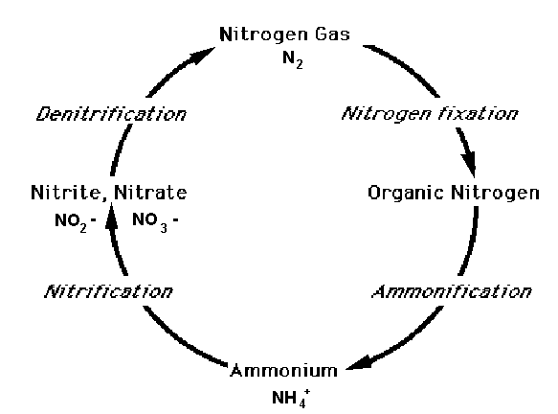
Nitrogen cycle
Organic matter
Waste products/ death
Ammonification
Animal protein
Ammonia nitrogen
N₂ gas
Animal life
Nitrification
Plant protein
Denitrification
Nitrite nitrogen
Plant life
Nitrate nitrogen
Oxidation
Notes:
Raw domestic wastewater contains around 40 mg/l of total nitrogen. This is typically measured as Total Kjeldahl nitrogen (TKN) as approximately 60% of the influent total nitrogen is ammonia and the remaining 40% is organic nitrogen.

Slide 4
Biological nitrogen removal
Assimilation nitrogen required for cell growth
Ammonification conversion of organic nitrogen to ammonia
Nitrification conversion of ammonia to nitrate
Denitrification conversion of nitrate to nitrogen gas
Notes:
Assimilation nitrogen is required for cell growth. Some of the nitrogen will be removed as new biomass is wasted from the system. Bacterial cells are about 12 % nitrogen
Ammonification The organic nitrogen will be hydrolyzed biologically in the aerobic treatment process to ammonia and become available to nitrification. A portion of the organic nitrogen will remain in the organic form and will either be removed physically or will pass through to the effluent. This step is rarely limits nitrification rates.
Biological removal of ammonia is a two step process that involves nitrification and denitrification. Discovered by accident in middle ages when trying to make saltpeter for gunpowder

Slide 5
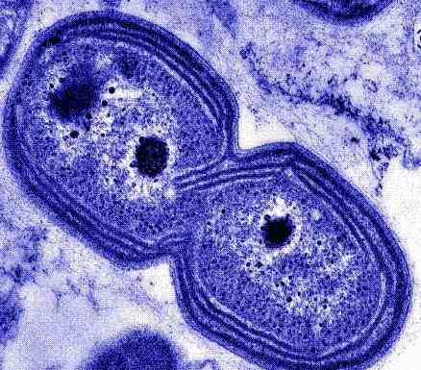
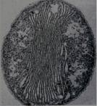
Nitrification
Ammonia + Oxygen + Alkalinity + Nitrosomonas (NH₃) (O₂)
= Nitrite (NO₂)
Nitrite + Oxygen + Alkalinity + Nitrobacter (NO₂) (O₂)
= Nitrate (NO₃)
Notes:
Nitrification is the changing of ammonia nitrogen into nitrite and then nitrate.
[CLICK] to bring in 2nd equation.
This is an aerobic process that requires lots of oxygen 4.57 mg per 1 mg of nitrogen oxidized. Consumes alkalinity at 7.14 mg CaCO3 per 1 mg nitrogen oxidized

Slide 6
The ‘bugs’
Nitrosomonas europaea
Nitrobacter

Slide 7
Nitrification
SRT long enough to allow stable population of nitrifiers to be maintained
HRT long enough to allow biomass sufficient time to react with ammonia
Assume well mixed conditions with no short circuiting
Short HRT can see season nitrification
Notes:
Nitrification must have a SRT long enough to allow a stable population of nitrifiers to be maintained. HRT long enough to allow biomass sufficient time to react with the ammonia
HRT System with longer HRT are less likely to see ammonia break through due to temperature changes, variation in flow and loading. Systems with short HRT can see season nitrification. For systems that are not designed to nitrify this can cause problems for bio P by changing the anaerobic zone to an anoxic zone.

Slide 8
Target SRT varies
With:
Temperature – 7ºC
Dissolved oxygen – 2 mg/L
pH – 6.8-8.0
Ammonia concentration
Notes:
Target SRT varies with temperature, DO, pH, and ammonia concentration. Temperature must be greater than 7 degree C to provide a stable population of nitrifiers. Dissolved Oxygen above 2.0 mg/l generally will not limit nitrification. Nitrifiers perform poorly with wide swings in pH, pH must be maintained between 6.8- 8.0. Effluent alkalinity of at least 50 mg/l and preferably 100 mg/l is recommended to stabilize the pH in the system.

Slide 9
Sensitive
Organic
Inorganic
Heavy metals
Notes:
Nitrifiers are sensitive to many organic and inorganic substances. Toxic substances must be eliminated from the system. Slow recovery due to growth rates. May not recover in winter.

Slide 10
Single sludge nitrification
Aeration tank
Clarifier
Influent
Effluent
Return activated sludge
Waste sludge
Notes:
Single Sludge Systems remove BOD and ammonia in the same reactor with only one set of clarifiers. Single sludge systems are common because many times denitrification is incorporated into the design, which would require the mixing of sludge or the addition of a carbon source.

Slide 11
Separate sludge nitrification
Aeration tank
Clarifier
Aeration tank
Clarifier
Influent
RAS BOD removal
RAS nitrification
Notes:
Separate Sludge Systems remove BOD in one set of reactors and clarifiers and remove ammonia in subsequent sets of reactors and clarifiers. Separate sludge systems protect the slow growing nitrifiers from influent wastewater that contains toxic materials and allow optimizing the nitrification system. They are less common because of higher construction costs and the incorporation of denitrification.

Slide 12
Denitrification
Nitrates (NO₃) + Organics + heterotrophic bacteria =
Nitrogen gas + Alkalinity (carbon dioxide)
2.86 mg CBOD/mg of nitrate
Anoxic zone less than 0.1 mg/L
Produces 3.57 mg of alkalinity
Notes:
Denitrification is the changing of nitrate to nitrogen gas.
This is an anoxic process that must have dissolved oxygen levels less than 0.1 mg/l. denitrifying bacteria are facultative and prefer to use oxygen to metabolize CBOD. Any oxygen in the zone will be used before the bacteria start to reduce the nitrate.
Denitrification There must be sufficient readily degradable CBOD in a well mixed anoxic zone. Denitrification consumes 2.86 mg CBOD per mg of nitrate denitrified because of efficiencies actual amount of CBOD required is closer to 4 mg. Carbon augmentation may be necessary with low CBOD to nitrogen ratios and in nearly all separate stage denitrification.

Slide 13
Basic removal of nitrogen in a wastewater facility
Nitrification
Denitrification
Aerobic
Nitrite ➔ Nitrate
(NO₂) (NO₃)
Anoxic
➔ Nitrogen gas
(N₂)
Ammonia (NH₃)
Notes:
Benefits to combined nitrification and denitrification
Denitrification will reduce 2.86 mg of the CBOD per mg of nitrate without the expense of adding air.
Reduce the alkalinity demand by producing 3.57 mg of alkalinity per mg of nitrate denitrified.

Slide 14
Denitrification
Wuhrmann process
Aeration tank
Anoxic tank
Clarifier
Return activated sludge
Notes:
A Wuhrmann Process is a single sludge nitrification system followed by an anoxic zone for denitrification. This system is limited by the lack of a carbon source in the anoxic zone also requires more alkalinity to maintain a steady pH in the aeration tank. Nitrogen gas in the clarifier inhibits settling.

Slide 15
Denitrification
Ludzack-Ettinger process
Anoxic tank
Aeration tank
Clarifier
Return activated sludge
Notes:
A Ludzack-Ettinger process places the anoxic zone upstream of the nitrification reactor to take advantage of the carbon source in the influent. Nitrates are introduced to the anoxic tank through the RAS. This system reduces the alkalinity demand and reduces CBOD without the expense of adding air in the anoxic zone. The system is limited by the amount of nitrate returned in the RAS.

Slide 16
Denitrification
Modified Ludzack-Ettinger process
Nitrified recycle
Anoxic tank
Aeration tank
Clarifier
Return activated sludge
Notes:
A Modified Ludzack-Ettinger process adds a mixed liquor recycle from the end of the aeration tank to the beginning of the anoxic tank. This returns more nitrates to the anoxic zone increasing the nitrogen that is removed. High recycle rates can introduced dissolved oxygen in the anoxic zone and dilute the substrate thereby reducing the performance.

Slide 17
Denitrification
Four-stage Bardenpho process
NO₃
Anoxic
Oxic
(aeration)
Anoxic
Oxic
(aeration)
Secondary clarifier
Influent
Effluent
Return activated sludge
Waste sludge
Notes:
Basically, using the principles of the modified Ludzack-Ettinger process for the first two stages and the Wuhrmann process for the final two stages to achieve a high level of total nitrogen removal.

Slide 18
Denitrification
Oxidation ditch
Oxic
Clarifier
Anoxic
Waste
sludge
Notes:
Oxidation ditches can perform biological nitrogen removal by creating an anoxic zone in parts of the ditch. This configuration is like Wuhrmann process. By changing the location of the aerators and mixers the oxidation ditch can operate like the Bardenpho process or the Modified Ludzack-Ettinger process. The oxidation ditch can create high recycle rates without the need for pumping the return.

Slide 19
Denitrification
Sequencing batch reactors (SBR)
Fill phase
React phase
Settle phase
Decant phase
Notes:
SBR perform all the necessary functions of nutrient removal in a single tank with variable water levels and timed aeration. This system requires a minimum of three tanks and advanced automation equipment to control the cycle times and phases. The SBR control systems allows the operation to be configured to operate as almost any other suspended growth reactor by adjusting the cycle phases between fill, mix, aerated, settle and decant.

Slide 20
Key ideas
Nitrification is an aerobic process that requires a long SRT and HRT
The length of the SRT is affected by
temperature
DO
pH
ammonia concentration
Denitrification is an anoxic process that requires very low DO with a carbon source

