Slide 1
BONDS AND OTHER FINANCING TOOLS
Office Professionals’ Seminar
October 29 & 30, 2019

Slide 2



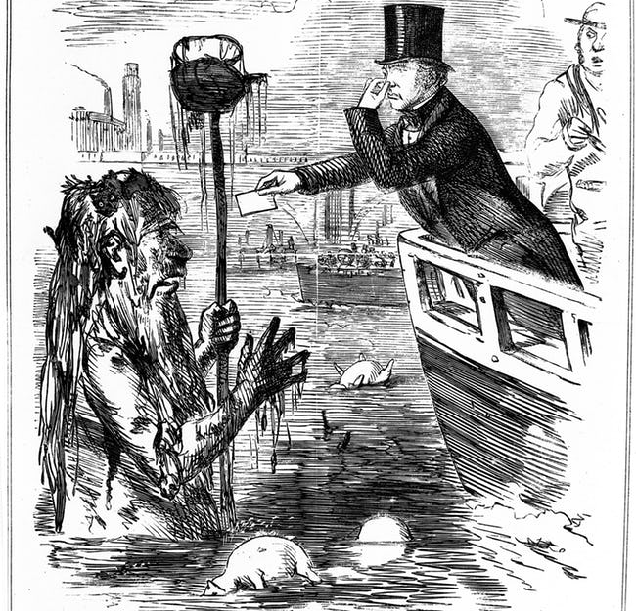
Water and Wastewater
Financing Options

Slide 3
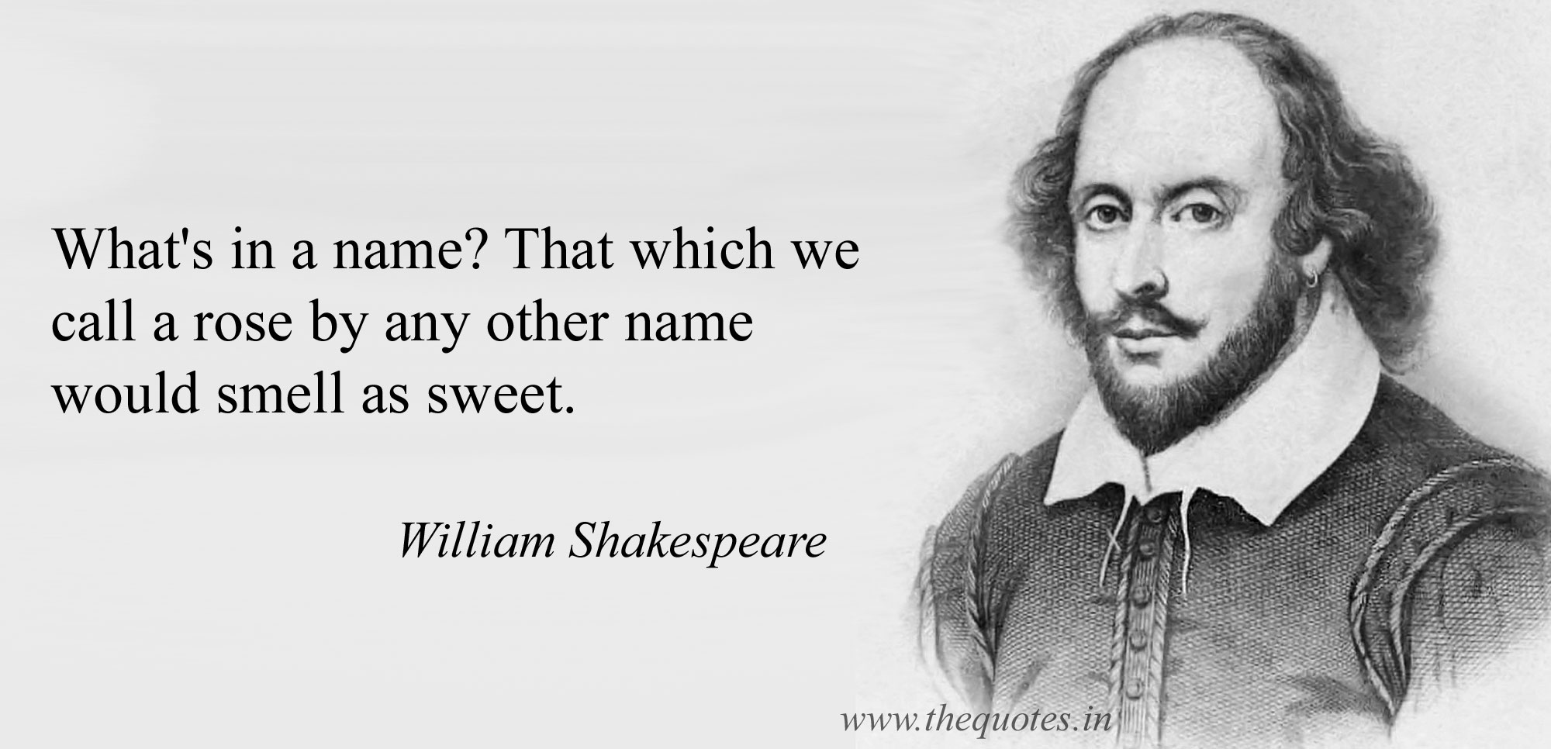
Types of Municipal Bonds
General Obligation Bonds
Utility Revenue Bonds
Neighborhood Improvement District Bonds
Lease Financings

Slide 4
Overview of
Municipal
Bonds

Slide 5

A Brief History
Since the late 1800s, municipalities have been issuing debt to raise money for capital improvements
Debt was often issued in the form of bonds to construct railroads and canals, allowing for westward expansion
Legal experts helped investors evaluate the legality and validity of various bond issues
Investor interest and confidence grew as transactions became more legally sound
Today, the municipal bond market is worth more than $3.8 Trillion
Primary and secondary trading of bonds takes place much like stocks

Slide 6

Why are Municipal Bonds Attractive to Investors?

Slide 7

Advantage of Tax-Exempt Bonds for Investors
  Taxable Equivalent Yield
  Example: 7.81%
= Tax-Free Yield
  100% - Tax Bracket
= 5.00%
  100% - 34%*
* Combined federal (28%) and Missouri (6%)

Slide 8
General
Obligation
Bonds

Slide 9

Security for
General Obligation Bonds
Full Faith and Credit and Taxing Power
Authorizes the governing body to levy an annual property tax (in any rate or amount) to repay the bonds
May use other revenue sources (such as sales tax revenues) to pay debt service on the bonds
A court can require an increase in property taxes if needed to repay the bonds

Slide 10
Constitutional Debt Limits
5% General Purpose
All Political Subdivisions
(Art. VI, Sec. 26(b))
10% Streets & Sewers
Cities Only
(Art. VI, Sec. 26(d))
10% Water, Electric & Light Plants
Cities Only
(Art. VI, Sec. 26(e))
Cities Cannot Exceed 20% Total!
5% General Purpose
Counties and Cities Only
(Art. VI, Sec. 26(c))

Slide 11


Super-Majority Voter Approval Required for General Obligation Bonds
4/7th Majority (57.1%) at General Municipal, Primary and General Elections
    April each year
    August and November in even-numbered years
    2/3rd Majority (66.6%) for All Other Elections

Slide 12

General Obligation Bonds
Advantages
Highest security, lowest risk, generally resulting in the lowest possible interest rate for financing the project
Less complex structure resulting in lower costs of issuance
Creates a new source of funds to repay the bonds
Disadvantages
20-year maturity limit
Voter authorization is required, which may delay the financing
Amount of bonds limited by the Constitution
Bonds are required to be registered with the Missouri State Auditor’s Office

Slide 13
Revenue
Bonds

Slide 14
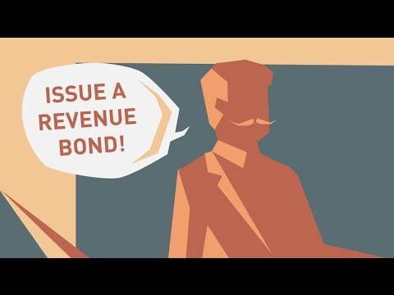
Types of
Revenue Bonds
Utility Revenue Bonds
Sales Tax Revenue Bonds
Housing Revenue Bonds
Hospital Revenue Bonds
Higher Education Revenue Bonds
Airport Revenue Bonds
Transportation Revenue Bonds
Industrial Revenue Bonds

Slide 15
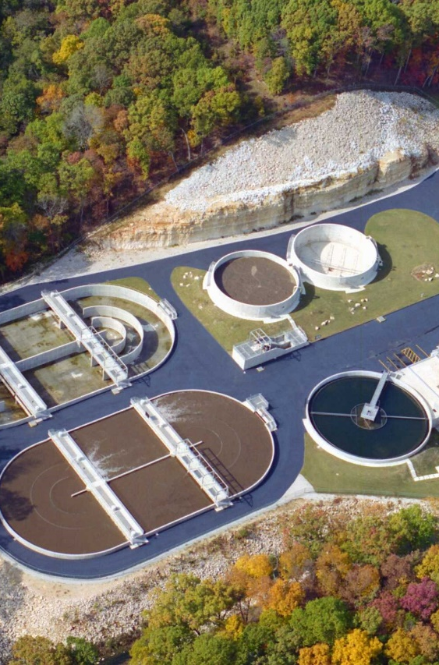
Utility Revenue Bonds

Slide 16

Security for
Utility Revenue Bonds
Pledge of revenues generated from the facility or project being financed (e.g., water, sewer, or combined system)
Authorizes the governing body to fix, establish, maintain and collect rates and charges for the services provided by the system to repay the bonds
May use other revenue sources (such as sales tax revenues) to pay debt service on the bonds

Slide 17


Simple-Majority Voter Approval Required for
Utility Revenue Bonds
With Some Exceptions:
Certain Reorganized Common Sewer Districts – No Voter Approval Required
Common Sewer Districts – 4/7th Super-Majority Voter Approval Required
Joint Municipal Utility Commissions – Approval from 3/4th of the Contracting Municipalities Required

Slide 18
Additional Bond Covenants
Rate Covenant
Debt Service Reserve Fund
(moneys that provide additional security for the bonds)
Depreciation and Replacement Fund
(moneys in case emergency repairs are needed to keep the System in good repair and working order)
Parity Bond Tests
Notes:
Senior or Junior Lien of Revenues
Application of System Revenues

Slide 19
Utility Revenue Bonds
Advantages
Generally, only a simple majority of voters is required to issue utility revenue bonds
System revenues are pledged to the repayment of bonds, which results in a lower interest rate
No constitutional limitations on amount – revenue bonds do not reduce ability to issue G.O. bonds
Disadvantages
35-year maturity limit (with some exceptions)
Voter authorization is required, which may delay the financing
Pledge of system revenues may require increases in rates – practical limitation on amount of bonds that can be issued
Parity test may limit ability to issue additional bonds

Slide 20
Neighborhood
Improvement Districts

Slide 21
NID Formation Basics
Several procedural steps involved in formation
Formation begins with property owner petition (signed by 2/3rds of the property owners by area) or election (either 4/7th or 2/3rd voter approval, depending on the election day)
Governing body holds a public hearing
Governing body levies NID special assessments on property in district boundary to pay for improvements
Governing body issues Quasi-General Obligation Bonds secured by assessment and surplus funds of the Issuer

Slide 22
Neighborhood Improvement District Bonds
Advantages
Creates a new source of funds to repay the bonds
Tax lien on properties plus full faith and credit of governmental entity provides solid security, reduced risk, generally resulting in the lower interest rate
Disadvantages
Only available to cities and counties
20-year maturity limit
Creation process may delay the financing and increase issuance costs
Bonds count against Constitutional debt limit
Bonds are required to be registered with the Missouri State Auditor’s Office
General fund of governmental entity at risk if assessments don’t come in as expected, Debt Service Reserve Fund recommended

Slide 23
Lease
Financings

Slide 24
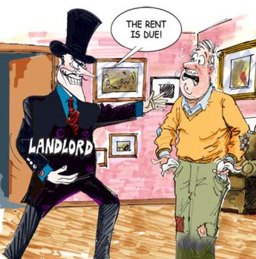
Security for
Lease Financings
Payable from all legally available funds; Collateral is the financed property
Lease is subject to renewal each year; no obligation to make rental payments beyond current lease term
No pledge of revenues
Rental payments are subject to annual appropriation
Collateral is subject to forfeiture if there is an event of default or non-appropriation

Slide 25


Lease Financings – Basic Structure
Purchaser
Lease Purchase Agreement (Annual Renewal)
Issuer
Base Lease
(Collateral)
$ Proceeds for the Project $
$ Rental Payments $

Slide 26
Lease Financings
Advantages
No voter approval required
No maturity limit
No constitutional limitations on amount – lease financings do not reduce ability to issue G.O. bonds
Disadvantages
Lease does not create a new source of funds to repay the obligation
Rental payments are subject to annual appropriation, - interest rate is typically higher than other types of bonds
Complex structure may result in higher costs of issuance
Debt Service Reserve Fund may be required
“Essential governmental facility” typically required as collateral to reduce the risk of non-appropriation

Slide 27


Slide 28
Erick S. Creach
Shareholder
Gilmore & Bell, P.C.
(314) 444-4110 ecreach@gilmorebell.com

